Slide 1

Risk Analytics for Trucking Fleet using Big Data
Identify high-risk cities, unsafe drivers, and inefficient vehicle models using geolocation, mileage, and fuel data.
BUAN 6346 – Big Data (Professor Waseem Shadid)
Group Members: Farid Farooq, Hiba Imad Abukhalaf, Sayedyounes

Slide 2




Objective & Overview
Identify high-risk cities
Detect unsafe driver behavior
Pinpoint operational inefficiencies
Normalize risk metrics
Analyze geolocation data to detect abnormal driving patterns in certain cities
Adjust KPIs to avoid scale bias, enabling fair comparison across vehicle types
Evaluate individual driver metrics like MPG to identify performance issues
Assess fleet efficiency by vehicle model, highlighting which models are underperforming
This big data analysis provides data-backed recommendations to improve truck safety and operational efficiency.

Slide 3





Workflow Diagram
CSV data files were initially uploaded to the local machine and then transferred to HDFS. Using Impala, necessary tables were created, including those for calculated fields and KPIs. Finally, Impala was connected to Power BI for visualization and analysis.

Slide 4
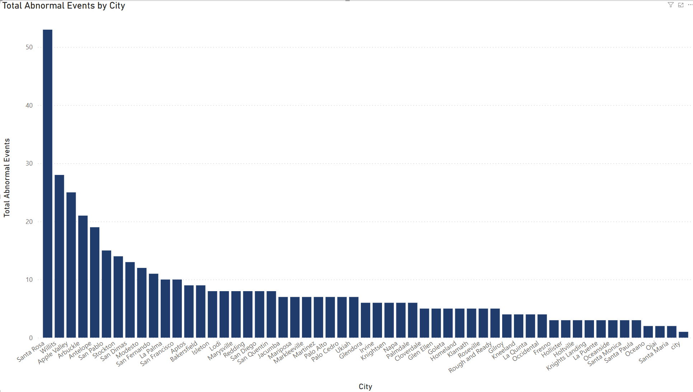
KPI 1 – Abnormal Events by City
Description:
Total number of non-normal events (e.g., harsh braking, idling, overspeeding) grouped by city.
Insight:
Santa Rosa, Willits, and Apple Valley show the highest frequency of abnormal events.
Recommendations:
Prioritize monitoring and policy interventions in top 3 cities
Review routes and schedules in these regions for risk exposure

Slide 5
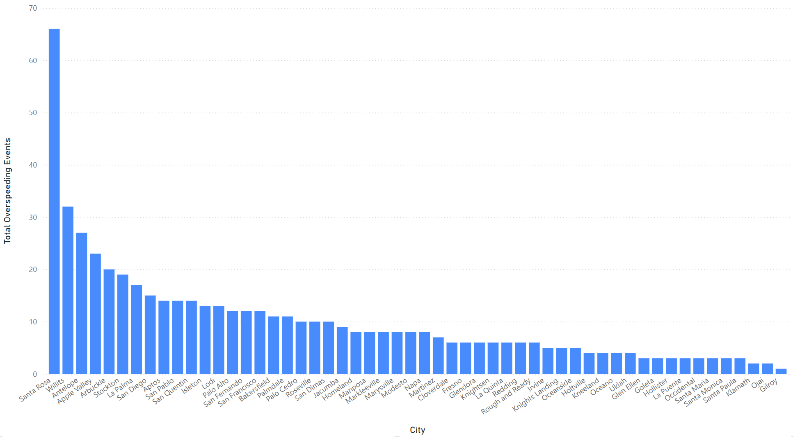
KPI 2 – Over speeding Events by City
Description: Frequency of overspeeding events recorded per city from geolocation data.
Insight: Santa Rosa again leads, indicating potential issues with speed limits or route conditions.
Recommendations:
Enforce stricter speed compliance for drivers assigned to these cities
Re-evaluate routing to avoid high-speed zones or provide alerts

Slide 6
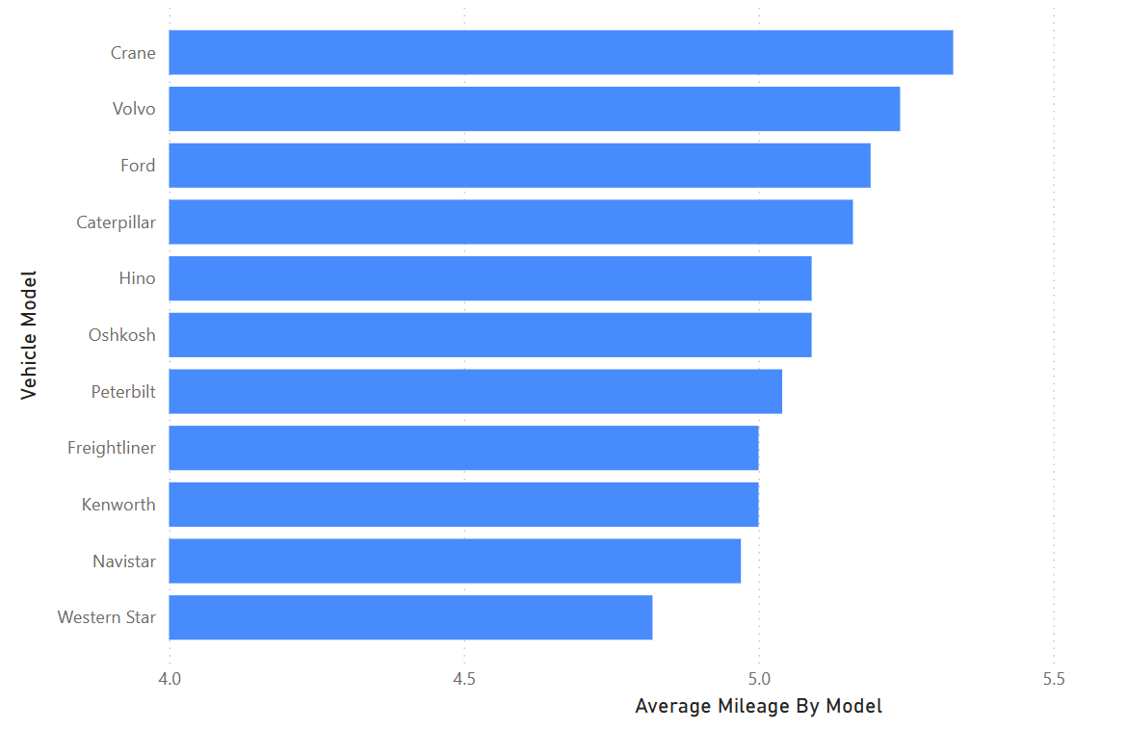
KPI 3 – Average MPG by Truck Model
Description: Average miles-per-gallon calculated per model across all recorded miles and gas usage.
Insight: Crane and Volvo are the most fuel-efficient models; Western Star ranks the lowest.
Recommendations:
Assign efficient models to longer routes
Phase out consistently low-efficiency models where possible

Slide 7
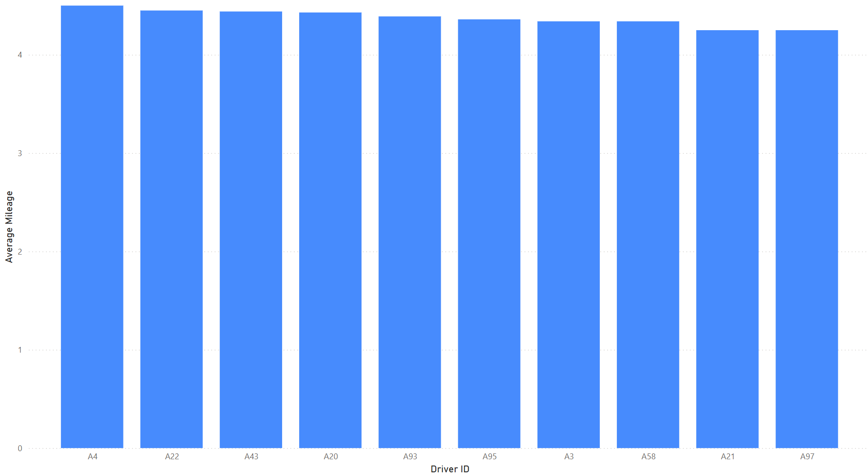
KPI 4 – Bottom 10 Drivers by MPG
Description: Drivers ranked by average MPG to flag inefficient driving behavior.
Insight: A97, A21, and A58 have the lowest fuel efficiency in the fleet.
Recommendations:
Schedule targeted fuel-efficiency training for these drivers
Monitor vehicle assignment to reduce impact on fuel costs

Slide 8
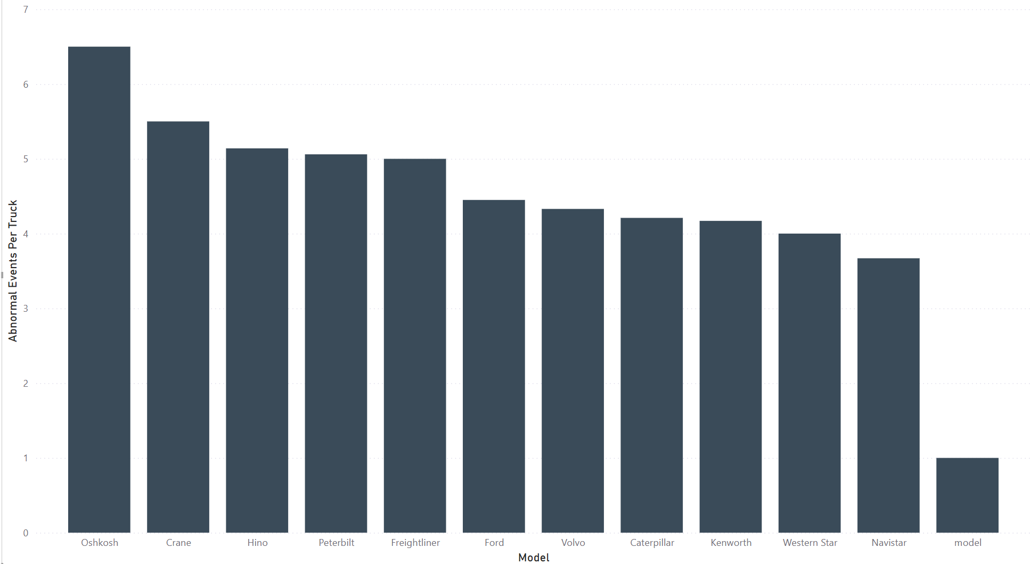
KPI 5 – Normalized Risk by Vehicle Model
Description: Total abnormal events normalized by number of trucks per model to avoid volume bias.
Insight: Oshkosh and Crane have the highest events per truck — a better risk indicator than raw totals.
Recommendations:
Audit Oshkosh and Crane vehicles for maintenance or usage issues
Consider usage policies or driver assignments by model risk score

Slide 9




Conclusion & Recommendations
Prioritize risk mitigation in Santa Rosa & Willits
Favor fuel-efficient models (Crane, Volvo)
The analysis shows Crane and Volvo trucks have the best average miles-per-gallon, suggesting these models should be prioritized for future procurement.
These cities have the highest frequency of abnormal driving events, indicating a need for targeted safety interventions.
Re-train underperforming drivers (A97, A21, A58)
Investigate high-risk models like Oshkosh for mechanical or driver-usage issues
Drivers with consistently low miles-per-gallon require performance coaching or route optimization to improve fuel efficiency.
The Oshkosh model shows the highest abnormal events per truck, indicating potential mechanical problems or driver-related issues that need to be addressed.
This big data-driven analysis surfaces clear opportunities to reduce risk and improve fleet efficiency through targeted interventions, driver training, and strategic procurement decisions.

